Slide 1
Squeezing Single-Cell Matrix Data
The Nathans (Pan & Blanken)
Notes:
Blanken

Slide 2
Develop a lossless compression algorithm for an NxM sparse matrix that uses less storage than existing formats.
Notes:
Blanken
Lossless is important because ALL biological data is important

Slide 3
Common Compressions
Notes:
Blanken

Slide 4
Format | Brief Description
MTX | Sparse matrix with genes as rows and cells as columns
HDF5 (.h5) | Hierarchical data format for large datasets
CSC (Compressed Sparse Column) | Matrix format to optimize for column-based operations
CSR (Compressed Sparse Row) | Like CSC but for row-based operations
H5AD | Based on HDF5 but separates the contents into different groups
Loom | Binary file specifically formatted for single-cell data
Notes:
Blanken
Some formats are fast and some are compact but none are perfect.

Slide 5
File Formats
Format | Pros | Cons | Usage
MTX | Easy parsing and readable | Inefficient for size because text based | Common for sparse matrices
HDF5 (.h5) | Compresses relatively well | Binary format and difficult to manage | General scientific data
CSC (Compressed Sparse Column) | Fast column slicing for sparse matrices | Slow for accessing specific row data | Matrix factorization
CSR (Compressed Sparse Row) | Fast row slicing for sparse matrices | Hard to get data in column form | Linear systems or iterative methods
H5AD | Specific for single-cell data and stores data in groups | Large files could require chunking for easier processing | Single-cell datasets
Loom | Allows partial file loading into memory | Not able to handle much metadata | Single-cell datasets

Slide 6
Our Ideas

Slide 7
COO format
Bit-packing
CSR-like format
Delta/Huffman
1D bitvector
Data stored as tuple (row, col, val)
Easy to create and update
Simple and flexible
Compress ints to store in minimal number of bits required
Eliminates wasted space
Ideal for int-based data structures
Reduce row array to count of non-zero values per row
Compression using delta encoding and Huffman coding
Delta encoding holds differences between neighboring values
Huffman coding sets frequently seen values with short bit lengths
Linear data structure of only zeros and ones
Used to represent existence of data at a particular index
Quick access for values given a known index

Slide 8
Starting Point: COO Format
Row:
0
0
0
1
1
3
3
3
Column:
3
7
8
0
6
2
3
9
Value:
17
4
2
5
3
52
9
1
Matrix[1, 6] has value 3
Notes:
Gets close to mtx.gz with bit packing but can be much efficient with row array

Slide 9
Bit-pack!
Row:
0
0
0
1
1
3
3
3
Almost as small as mtx.gz file! Can we squeeze more?
Column:
3
7
8
0
6
2
3
9
Value:
17
4
2
5
3
52
9
1

Slide 10
Compress Row Array By Count
Row (orig.):
0
0
0
1
1
3
3
3
At row[i] we store the number of non-zero values in row i (a modified CSR format)
Row (new):
3
2
0
3
Column:
3
7
8
0
6
2
3
9
Value:
17
4
2
5
3
52
9
1

Slide 11
Alternative: Bit Vector Indices
Matrix:
0001000110100000100000000000000011000001
Value:
17
4
2
5
3
52
9
1
Convert NxM matrix into 1D array and store 1s in bit vector to indicate position of non-zero entries.
Matrix entry associated with non-zero bit stored in value[rank(b)]

Slide 12
More Efficient Encodings
Delta encoding
Currently only implemented for column array (deltas reset per row)
Row array is equivalent to delta encoded CSR row array shifted left one
Huffman coding
Coding derived separately for each array
Bit-level run length encoding for bit vector
Notes:
During initial testing we found that delta encoding column array was the only one with benefit and haven’t re-tested it on other arrays

Slide 13
Drawbacks
Not easy to iterate through
Requires linear scan and decode for any operation
What’s not so great…
Notes:
Blanken
We accept these drawbacks since we are purely optimizing for storage
These formats aren’t easy to iterate unless you decompress so think about storage efficiency not lightning runtime.

Slide 14
Data
Notes:
Blanken

Slide 15

10x Genomics
Provides data in HDF5 format and gzipped MTX format
We converted from MTX to the remaining formats using SciPy and AnnData libraries
Notes:
Blanken
We used MTX format as input to our compression

Slide 16
Results
Notes:
Blanken

Slide 17
We did it…
Notes:
Blanken

Slide 18
The “30,000 feet”
Our compressions resulted in smaller files than other compressions
GZipping made those files even smaller
High level overview of results
Notes:
Blanken
We beat every common file format and once we compressed out files it wasn’t even close.

Slide 19
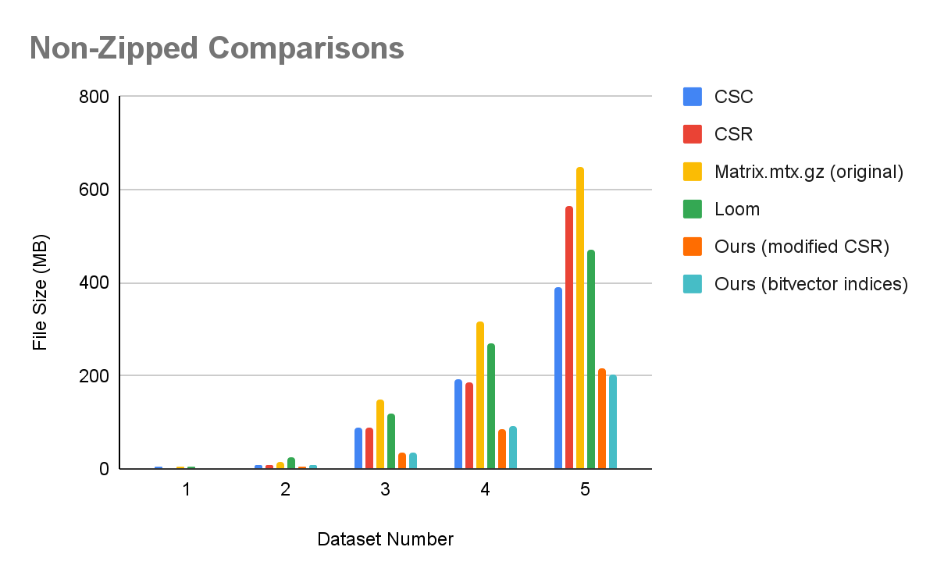
Notes:
Our non-zipped files average 62% reduction compared to other methods non-zipped files
Largest reduction was dataset 5 h5ad vs our bitvector indices + GZip.

Slide 20
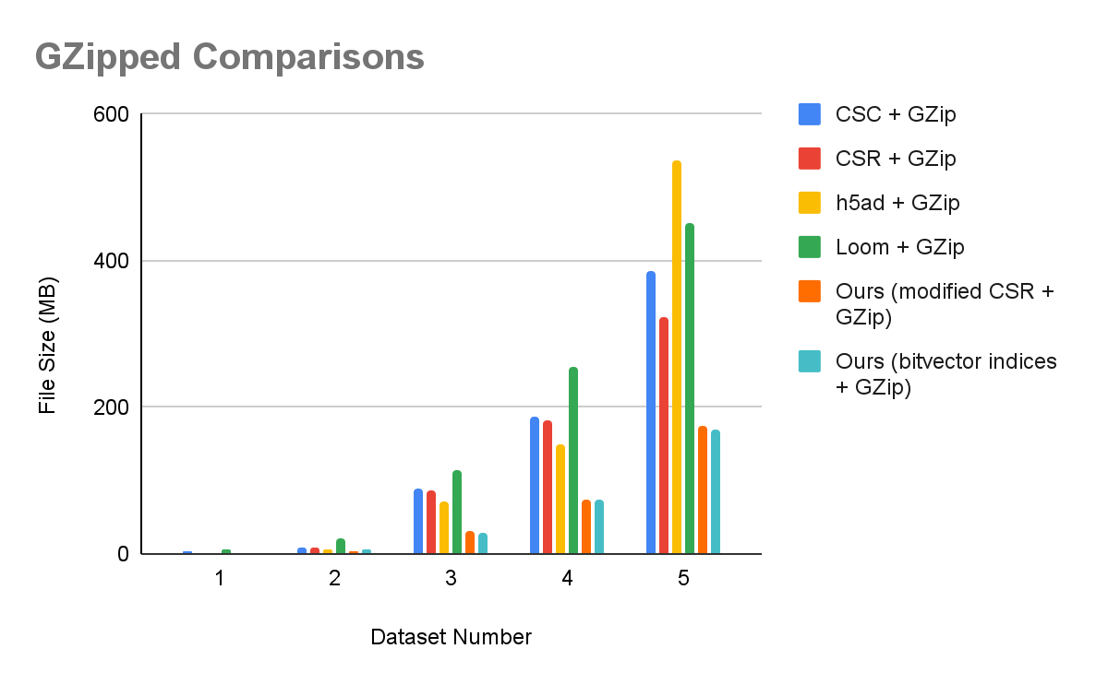
Notes:
Our GZip files average 58% reduction compared to other methods GZipped

Slide 21
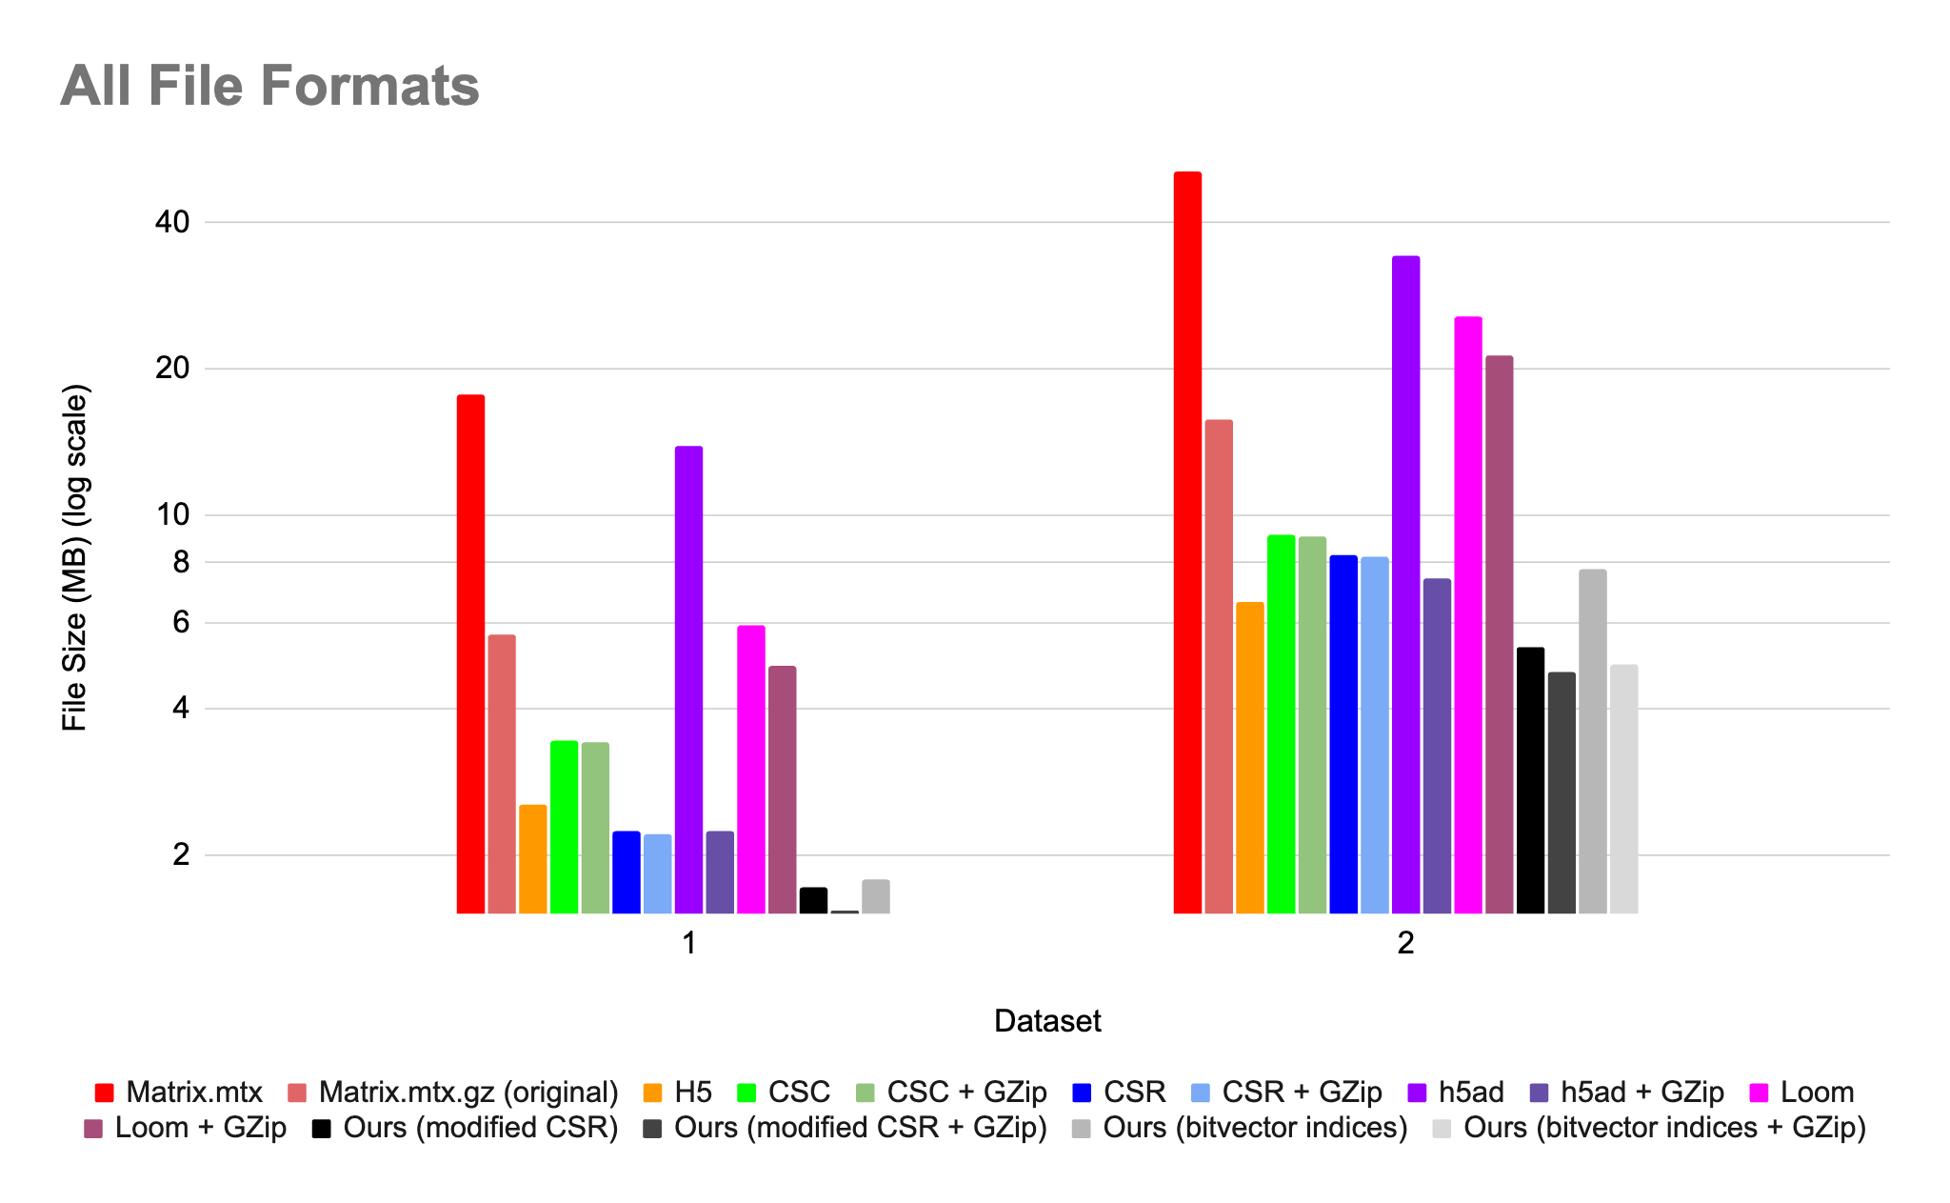
Notes:
Our compressions average 72% reduction compared to original file sizes

Slide 22
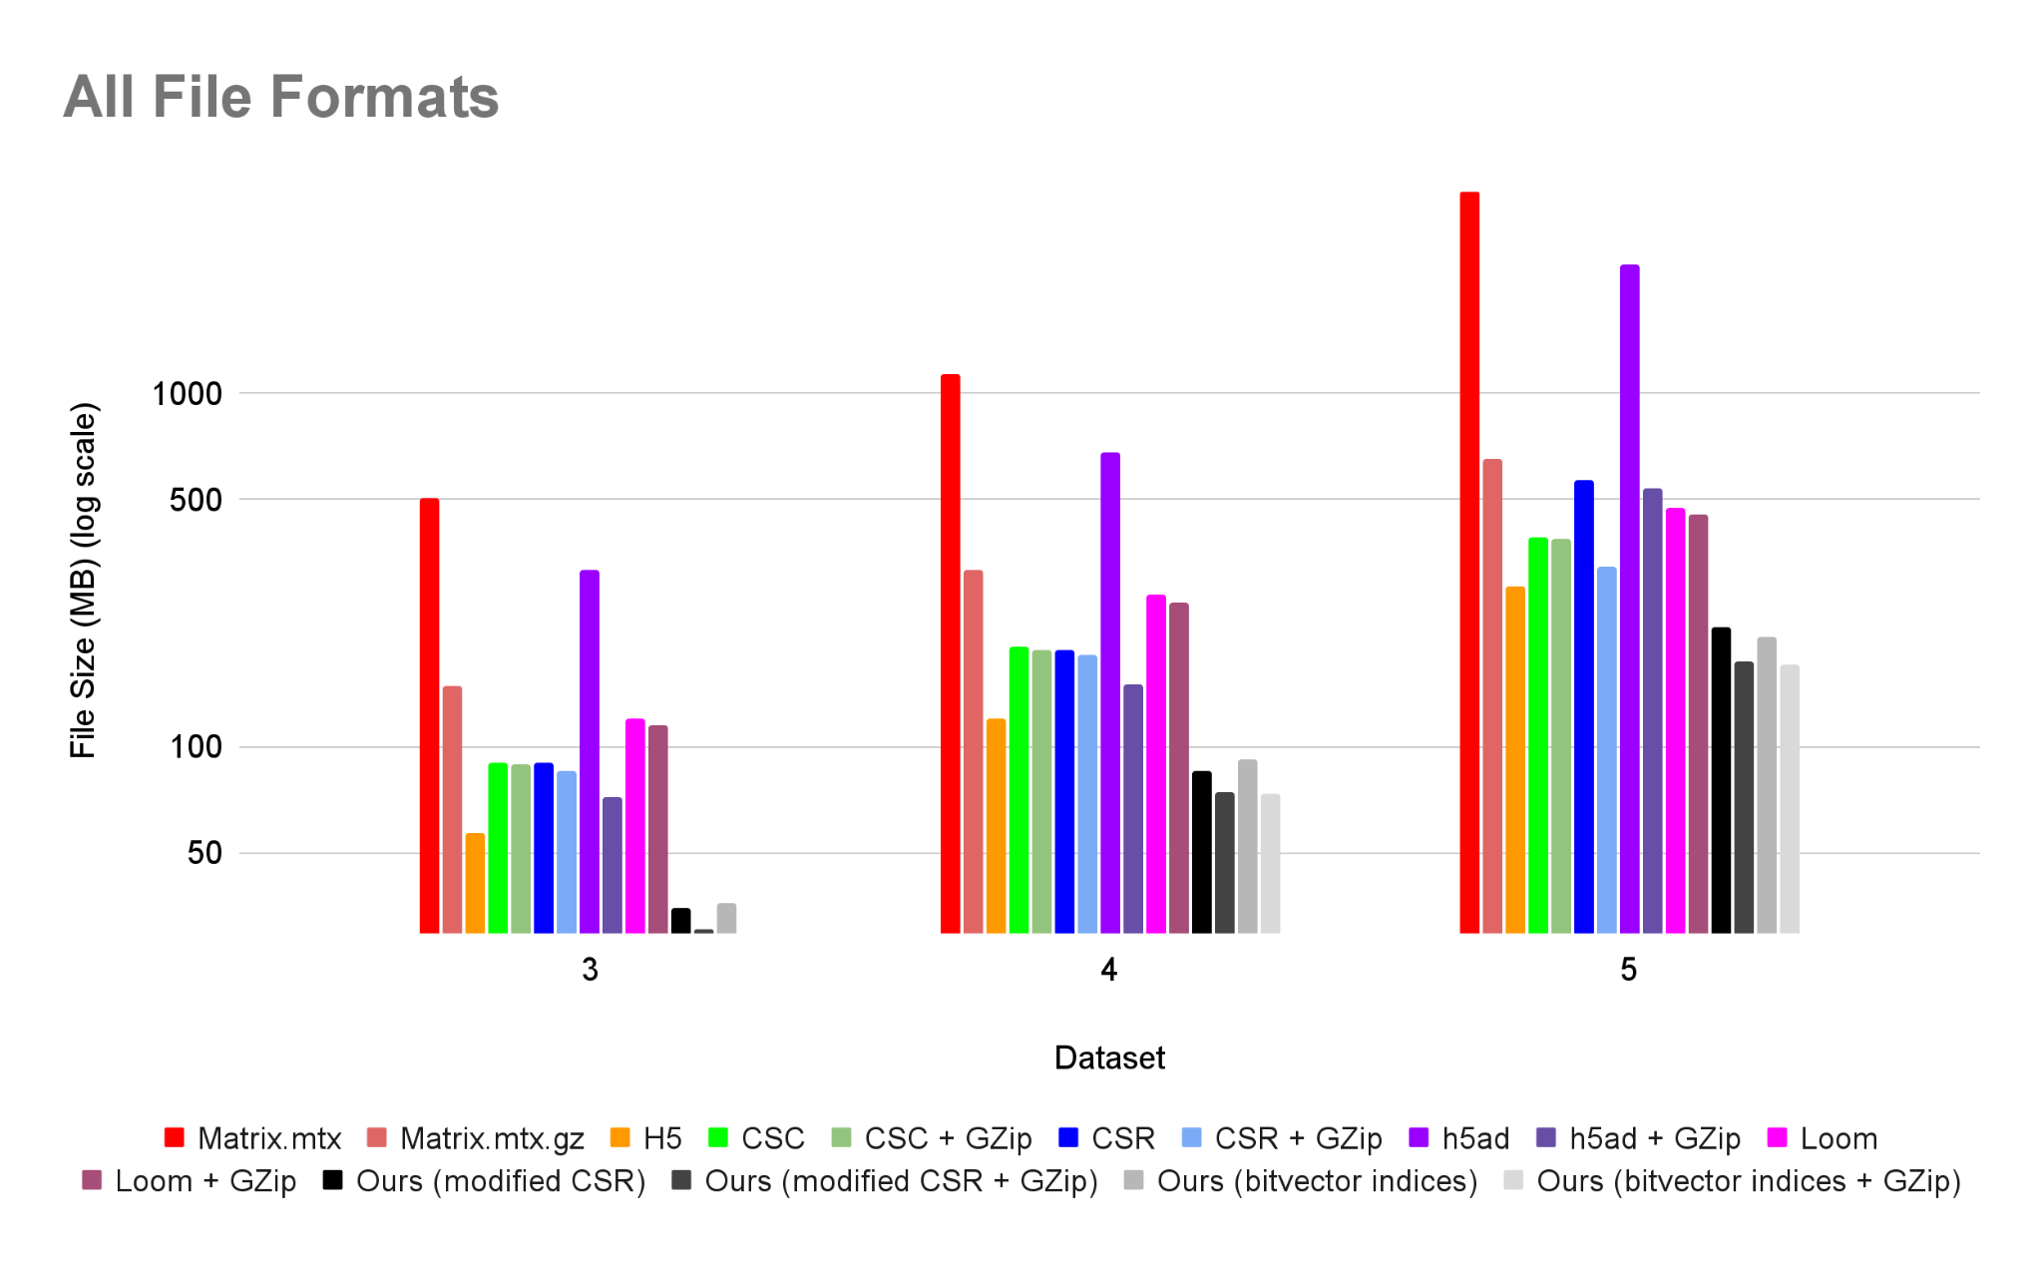
Notes:
Our compressions average 72% reduction compared to original file sizes

Slide 23
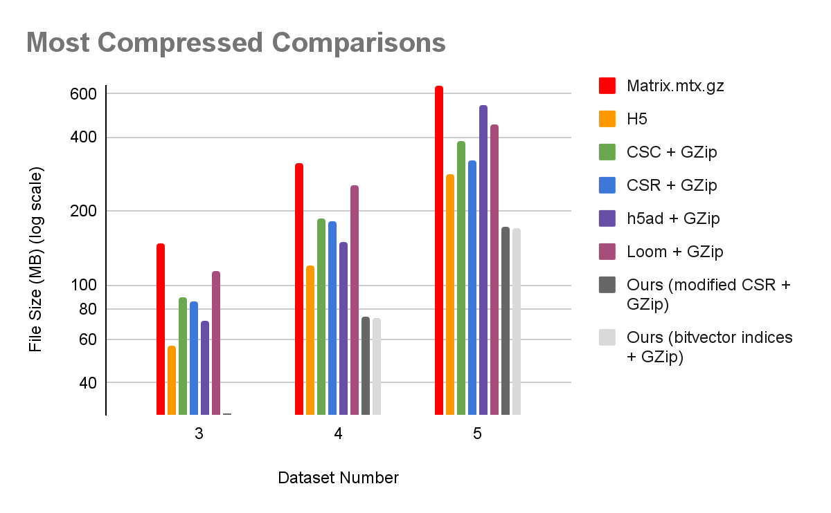

Slide 24
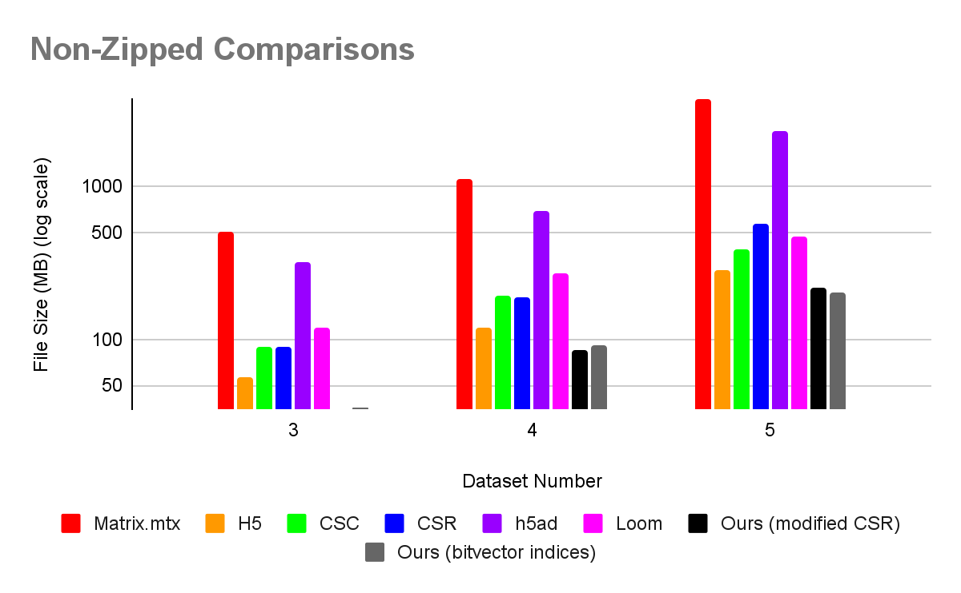

Slide 25
Conclusions
CSR-like format compressed better than other formats in all tests, even without gzip
Avg. 70% reduction in file size from original mtx.gz
1D bit vector format + gzip resulted in best compression
Avg. 74% reduction in file size from original mtx.gz
GZip
Modified CSR or bitvector indices
Notes:
Blanken
Our CSR variant is good but the 1D bit vector is even better
GZipping the 1D bit vector gave best results at 74% file size reduction

Slide 26
Future work
Test deriving Huffman coding from all arrays combined instead of individually
Re-test delta encoding row and value arrays
Test on more datasets
Notes:
Blanken
Huffman coding one large array would be better than individual huffman codings
More tests with delta encoding on all arrays
Larger datasets

Slide 27
References
https://en.wikipedia.org/wiki/10x_Genomics
https://crates.io/crates/matrix-market-rs
https://crates.io/crates/minimum_redundancy
https://crates.io/crates/bitfield-rle
https://anndata.readthedocs.io/en/stable/
https://www.elucidata.io/blog/single-cell-rna-seq-data-analysis-beyond-h5ad
https://www.neonscience.org/resources/learning-hub/tutorials/about-hdf5
https://www.geeksforgeeks.org/compressed-sparse-formats-csr-and-csc-in-python/
https://www.cs.uaf.edu/~olawlor/papers/2013/compression/lawlor_compression_2013.pdf
https://ieeexplore.ieee.org/document/4625888
https://dl.acm.org/doi/pdf/10.1145/1183401.1183444
https://taahmedsror.wordpress.com/wp-content/uploads/2012/03/run-length-encoding.pdf
https://broadinstitute.github.io/wot/file_formats/#:~:text=5.0-,MTX,row%20and%20column%20indices%2C%20respectively.
Datasets
https://www.10xgenomics.com/datasets/500-human-pbm-cs-3-lt-v-3-1-chromium-x-3-1-low-6-1-0
https://www.10xgenomics.com/datasets/whole-blood-rbc-lysis-for-pbmcs-neutrophils-granulocytes-3-3-1-standard
https://www.10xgenomics.com/datasets/10k-human-pbmcs-3-v3-1-chromium-x-with-intronic-reads-3-1-high
https://www.10xgenomics.com/datasets/20-k-1-1-mixture-of-human-hek-293-t-and-mouse-nih-3-t-3-cells-3-ht-v-3-1-3-1-high-6-1-0
https://www.10xgenomics.com/datasets/full-chip-mixture-of-drug-treated-h1975-and-a549-cells-targeted-gene-expression-gene-signature-3-1-high

